Slide 1

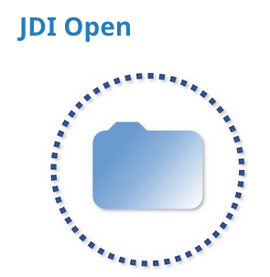
Open Science and your career
Bennett Kleinberg

Slide 2
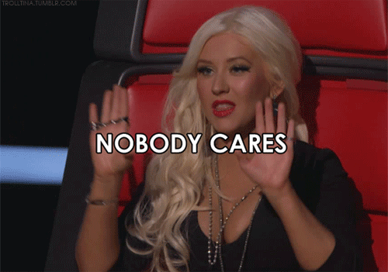
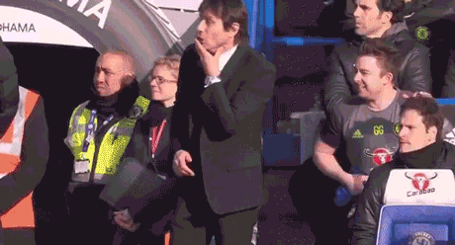
Attitudes towards Open Science
“Mainstream“ perception

Slide 3

Attitudes towards Open Science
The “hidden” 3rd type
The Enthusiast
The Stoic
The ‘other’ type

Slide 4

Three perceptions of Open Science
The Enthusiast
Loves Open Science
Registered on the OSF before it was a thing
Has an arXiv newsletter
Preregisters her/his studies
All data openly available
Transparent research methods
Publishes open-access papers
Many early-career researcher, PhD student, post-doc

Slide 5
Three perceptions of Open Science
The Stoic
Thinks Open Science is a fashion
Thinks OSF stands for something else?
Finds preprints low quality research
Preregistrations are “just not how I do research”
Thinks data are her/his own
Thinks the method section of a paper is an annoyance
Doesn’t care about open access
Many late-career researchers

Slide 6
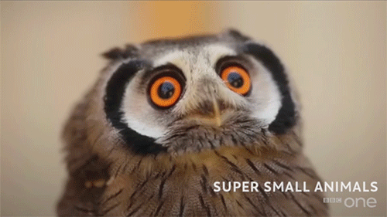
Three perceptions of Open Science
The “other”
Aware of Open Science
Knows about arXiv, OSF, etc.
Doesn’t like preprints but can’t tell you why
Preregistrations just cost time
Data sharing is a pain
“It worked fine without Open Science…” →
Open access: Whatever!?
ECR, PhD student, post-doc with academic ambition

Slide 7
Why you should must care?
Becoming less vulnerable in science
Staying relevant
Becoming valuable

Slide 8
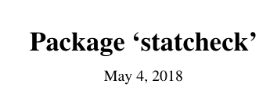
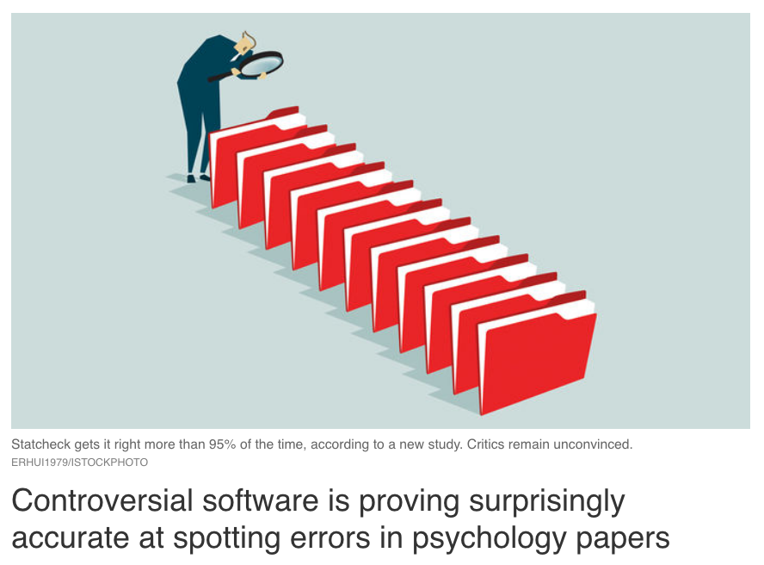
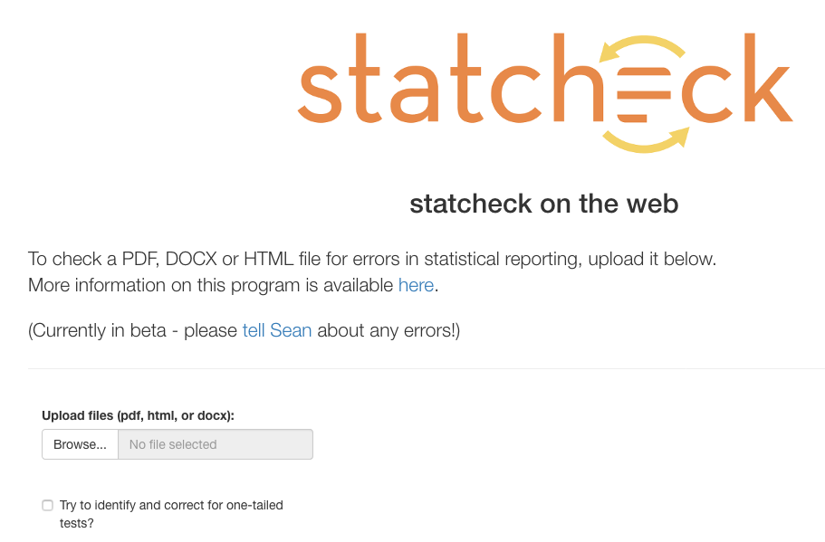
BECOMING LESS VULNERABLE
… by making yourself vulnerable?

Slide 9
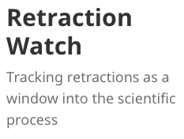
BECOMING LESS VULNERABLE
… by making yourself vulnerable?
Ongoing and future efforts:
Assess scientific quality at scale
Document open science research at scale
Asking the feared questions
For the individual and the discipline
Doing Open Science protects

Slide 10
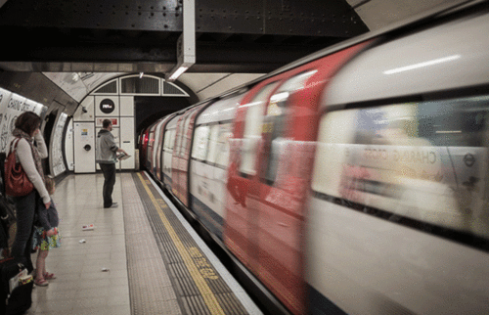
STAYING RELEVANT
Open science practices are increasing

Slide 11
STAYING RELEVANT
Journals with open data requirement:
- Science, Nature, Scientific Reports, PNAS, …
+
"I request that the authors add a statement to the paper confirming whether, for all experiments, they have reported all measures, conditions, data exclusions, and how they determined their sample sizes.
The authors should, of course, add any additional text to ensure the statement is accurate. This is the standard reviewer disclosure request endorsed by the Center for Open Science [see http://osf.io/hadz3]. I include it in every review."

Slide 12
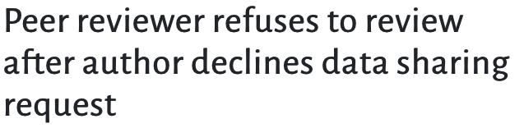
STAYING RELEVANT
The Openness Initiative
Data should be made publicly available
Stimuli and materials should be made publicly available.
In case some data or materials are not open, clear reasons (e.g., legal, ethical constraints, or severe impracticality) should be given why.
Documents containing details for interpreting any files or code, and how to compile and run any software programs should be made available with the above items.
The location of all of these files should be advertised in the manuscript, and all files should be hosted by a reliable third party.
https://opennessinitiative.org/the-initiative/

Slide 13









STAYING RELEVANT
Candidates are asked to describe in what way they have already pursued and/or plan to pursue open science

Slide 14
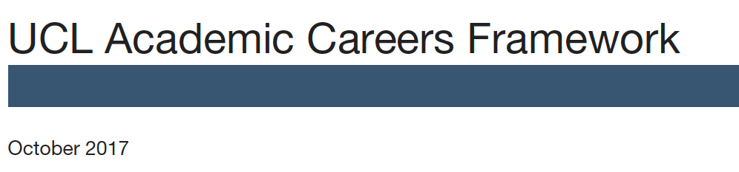
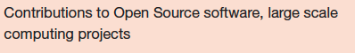
STAYING RELEVANT

Slide 15
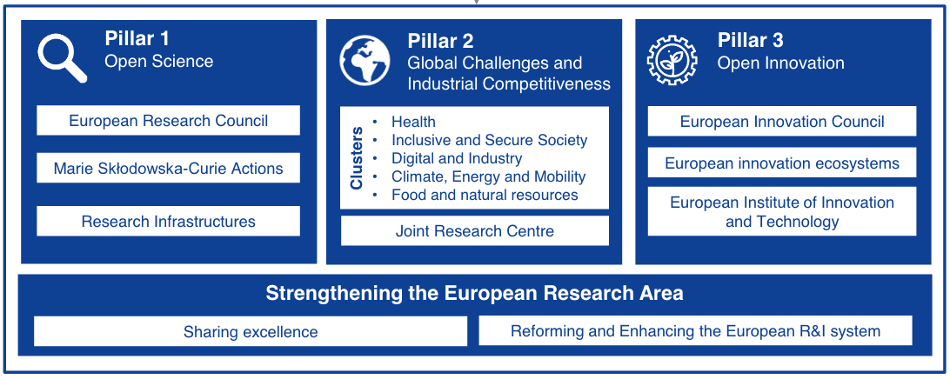
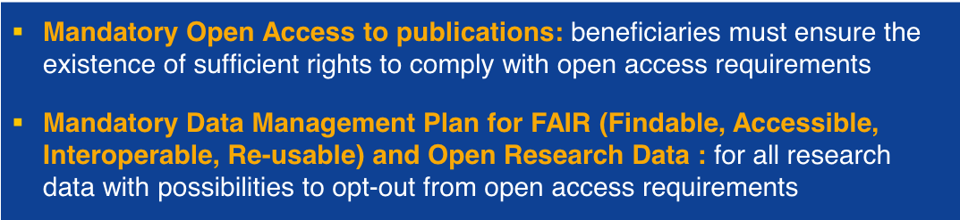
BECOMING VALUABLE
Horizon 2020 becomes Horizon Europe
Budget: EUR 100 billion over 6 years

Slide 16
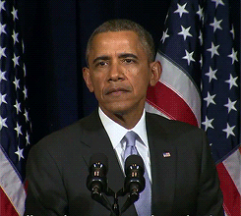
Cool…

Slide 17


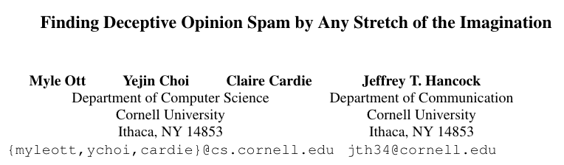
Why you should must want to care!
Less stressful
People use “your” data!
Two examples
+
> 750 citations
+
> 20 methods/studies building directly on that dataset
Practically all newspapers!

Slide 18
Take home message
1. Don’t be that guy!
2. Even if you don’t like it, you should want to care about Open Science.
… even if it’s just for your own career

